Slide 1








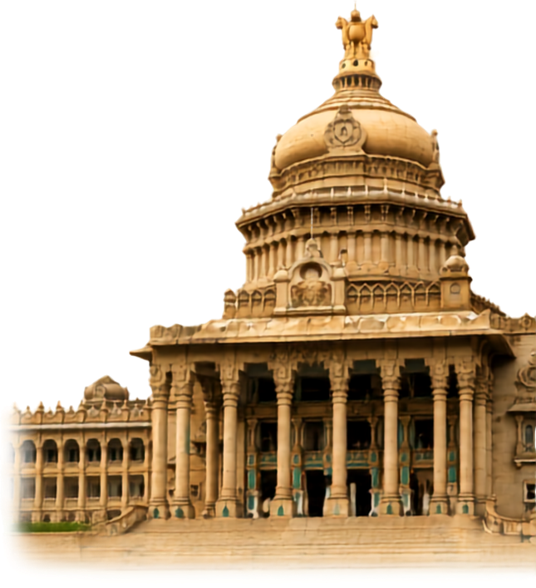
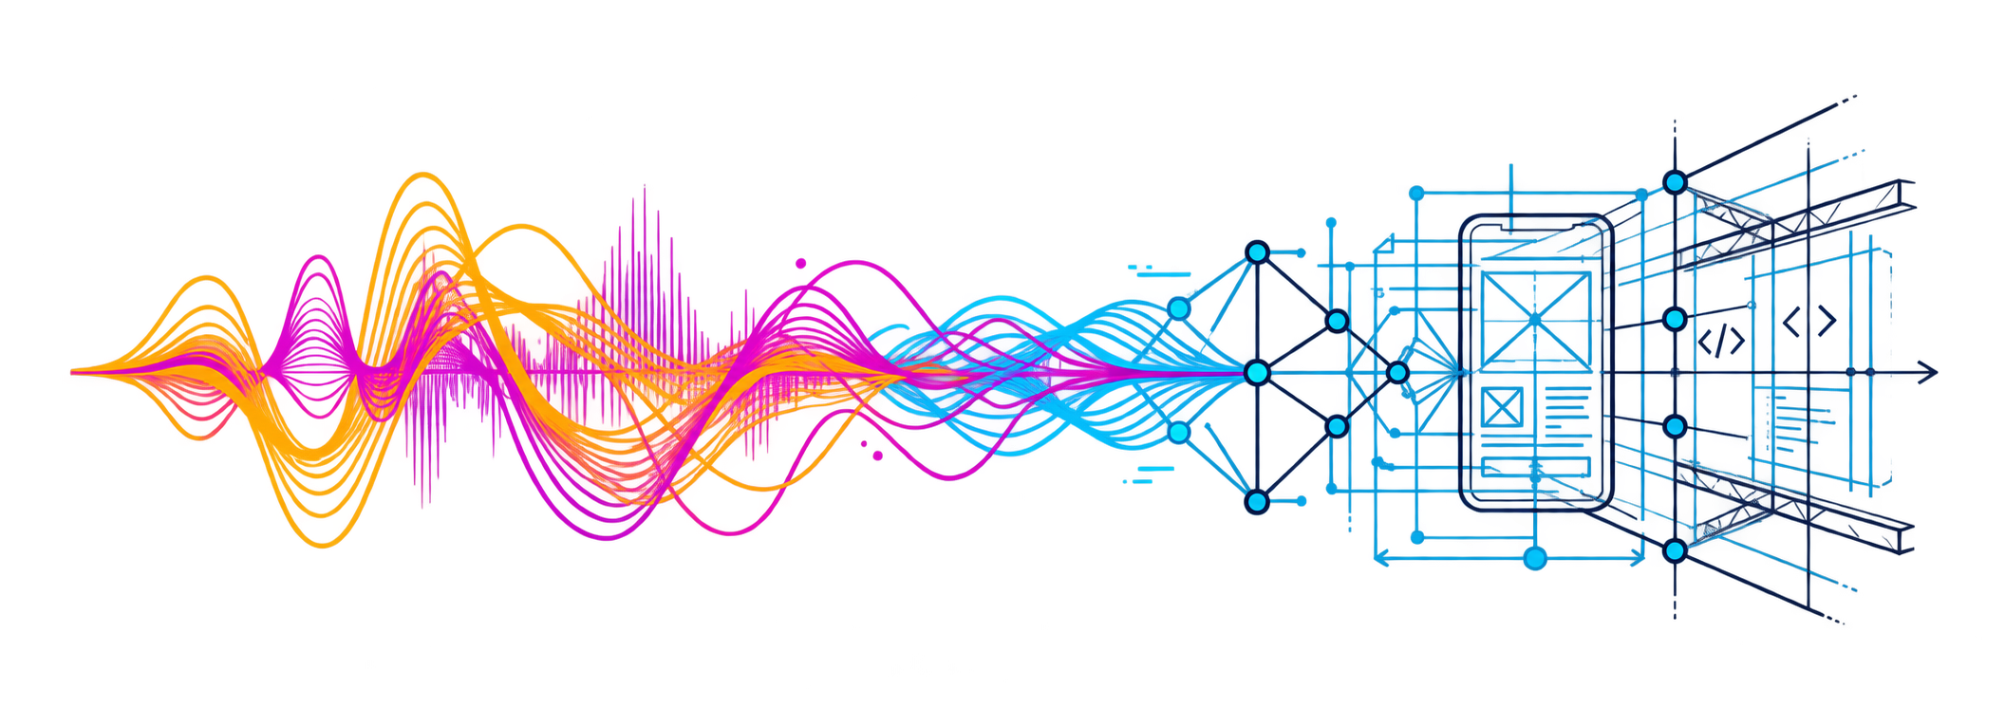

MANIPAL
  ACADEMY OF HIGHER EDUCATION
  Institution of Embrace Diamant in the University
VAANI
वाणी
The voice-first BRD agent for India’s business owners
Speak your requirements. Get a verified BRD and a working app.
Sarvam AI · PS41 / Track 4 · BRD Generation Agent
AIForge
HackSprint 2026
ORGANIZED BY:
MANIPAL
  ACADEMY OF HIGHER EDUCATION
  Institution of Embrace Diamant in the University
Notes:
VAANI is a voice-first business builder for Indian business owners. Team AIForge, HackSprint 2026. Track supplied as Sarvam AI × Paytm, BRD Generation Agent. Presenter name and numeric track ID were not supplied. The cover retains original sponsor and event branding from the template.
Sources: User-supplied seven-slide VAANI outline (Pasted text.txt). Visual reference: https://notebook.google.com/notebook/032263ef-21e1-4d8b-8fb0-787156850e2c/artifact/38578414-83aa-4f77-8d5d-9e8abc2d5def
The project brief, technical build and execution plan named in the outline were not supplied separately. Every capability on this slide is implemented in the repository and covered by 58 backend tests and 11 browser flows (verified 17 Oct 2026).

Slide 2
Solution
Requirements in the owner’s language, verified word by word
01
Speak your business
02
Preserve the logic
Voice, typed notes or a pasted chat in Hindi, Kannada, Tamil, Telugu, Marathi, Bengali or English.
Every requirement quotes the speaker verbatim; every number must have been spoken.
03
The agent interviews
04
Catch disagreements
It checks the 8 things a BRD needs and asks for what is missing, aloud, in your language.
Owner says 50 kg, manager says 100 kg: both voices side by side, one decision.
05
Approve with your voice
06
BRD + working app
Hear the original clip, hear the rule read back by Bulbul, then sign off.
12-section BRD in 7 languages (PDF, Word, Jira CSV) and a first app generated from it.
Nothing the AI writes reaches the BRD unless someone actually said it.
Notes:
The core problem is loss of business meaning when vernacular descriptions become English specifications. VAANI preserves conditions, thresholds, numbers and exceptions as structured rules. The proposed workflow supports local-language voice and text, prototype generation, deterministic replay, owner approval and voice-to-collect. The payment flow needs confirmation before creating a request.
Sources: User-supplied seven-slide VAANI outline (Pasted text.txt). Visual reference: https://notebook.google.com/notebook/032263ef-21e1-4d8b-8fb0-787156850e2c/artifact/38578414-83aa-4f77-8d5d-9e8abc2d5def
The project brief, technical build and execution plan named in the outline were not supplied separately. Every capability on this slide is implemented in the repository and covered by 58 backend tests and 11 browser flows (verified 17 Oct 2026).

Slide 3
Tech Stack & Architecture
A thin backend connects the experience, Sarvam and the verifier
Frontend
Python + FastAPI
Sarvam AI
React + Vite
Plain CSS, offline single-file build
Voice-first UI; verifier re-runs on every edit
Interview agent and extraction
Deterministic verifier
Evidence hashes, response cache, server-side keys
Saaras v4 · Bulbul v4-flash · Translate · 105B
Gemini
Long BRD drafting and app generation
OUTPUTS
Verified requirements
Conflict detection
Developer BRD
Voice trace + app
Verbatim quotes, spoken numbers
Stakeholders who disagree, with both voices
12 sections, FR-IDs, Jira CSV, Word, PDF
Every rule plays back; a first app from the BRD
API keys stay server-side. The generated app runs sandboxed with no network access.
Notes:
Proposed stack: React, Vite, Tailwind and Framer Motion on the frontend. Python and FastAPI provide a thin server-side proxy for Sarvam, the LLM and payment credentials. Sarvam provides STT, TTS and translation. The rule engine preserves conditions and exceptions, then an orchestrator creates ScreenSpec, BRD and replay inputs. React assembles a constrained set of pre-built components. Outputs include an interactive prototype, a Dhandha Twin replay, developer BRD and voice audit trail.
Sources: User-supplied seven-slide VAANI outline (Pasted text.txt). Visual reference: https://notebook.google.com/notebook/032263ef-21e1-4d8b-8fb0-787156850e2c/artifact/38578414-83aa-4f77-8d5d-9e8abc2d5def
The project brief, technical build and execution plan named in the outline were not supplied separately. Every capability on this slide is implemented in the repository and covered by 58 backend tests and 11 browser flows (verified 17 Oct 2026).

Slide 4
How it works
One conversation becomes a BRD the owner can hear and a vendor can build
01 Speak
02 Understand
03 Interview
04 Extract
Owner describes the business in their language.
Saaras v4 transcribes code-mixed speech with timestamps.
The agent asks for the missing goal, users, budget or timeline, aloud.
Requirements with verbatim quotes and spoken numbers.
The same verifier runs in Python and in the browser
05 Verify
06 Resolve
07 Approve
08 Deliver
Unspoken numbers and invented items are blocked, visibly.
Conflicts between speakers are shown with both voices.
Owner hears each clip and the read-back, then signs off.
BRD in 7 languages, Jira CSV, generated app, voice trace.
Example: reorder cardamom below 50 kg (owner) vs below 100 kg (manager): VAANI asks, not guesses.
Notes:
The proposed end-to-end sequence has eight stages: speak, understand, extract, build, materialise, simulate, approve and deliver. A business rule example is to pause Grade-B iron purchases for three days when the dollar rises, unless there is a confirmed order. Numeric thresholds that were not spoken must be clarified with the owner before final approval. Digital Twin results depend on the sample data, baseline and assumptions.
Sources: User-supplied seven-slide VAANI outline (Pasted text.txt). Visual reference: https://notebook.google.com/notebook/032263ef-21e1-4d8b-8fb0-787156850e2c/artifact/38578414-83aa-4f77-8d5d-9e8abc2d5def
The project brief, technical build and execution plan named in the outline were not supplied separately. Every capability on this slide is implemented in the repository and covered by 58 backend tests and 11 browser flows (verified 17 Oct 2026).

Slide 5
Data Flow Diagram
Every box is a real step in the running product
Voice / text
Sarvam AI
Interview agent
Extraction
Verifier
Owner, manager, notes
Saaras · Translate · Bulbul
8-point gap check
Quotes + spoken numbers
Blocks what nobody said
Awaaz Proof
BRD
Conflict detector
Generated app
Each requirement links to a SHA-256-hashed clip of the original recording, with timestamps.
Requirements and business rules
Owner vs manager
Keep A / keep B / defer
Built from the approved BRD
Sandboxed, no network
Approval records who and when. It is not an e-signature, and the product says so.
Notes:
Audio or text enters Sarvam, then structured extraction produces business rules with IF, THEN and UNLESS logic. The orchestrator creates ScreenSpec for the React renderer. Structured rules also feed the BRD and Dhandha Twin. Awaaz Proof uses voiceClipId to preserve provenance across the rule, screen component, payment action and replay outcome. The owner tests and corrects the generated application through voice. Voice-to-collect takes the customer and amount, asks for confirmation, and generates a UPI QR or payment link. Actual payment authentication remains in the UPI app.
Sources: User-supplied seven-slide VAANI outline (Pasted text.txt). Visual reference: https://notebook.google.com/notebook/032263ef-21e1-4d8b-8fb0-787156850e2c/artifact/38578414-83aa-4f77-8d5d-9e8abc2d5def
The project brief, technical build and execution plan named in the outline were not supplied separately. Every capability on this slide is implemented in the repository and covered by 58 backend tests and 11 browser flows (verified 17 Oct 2026).

Slide 6
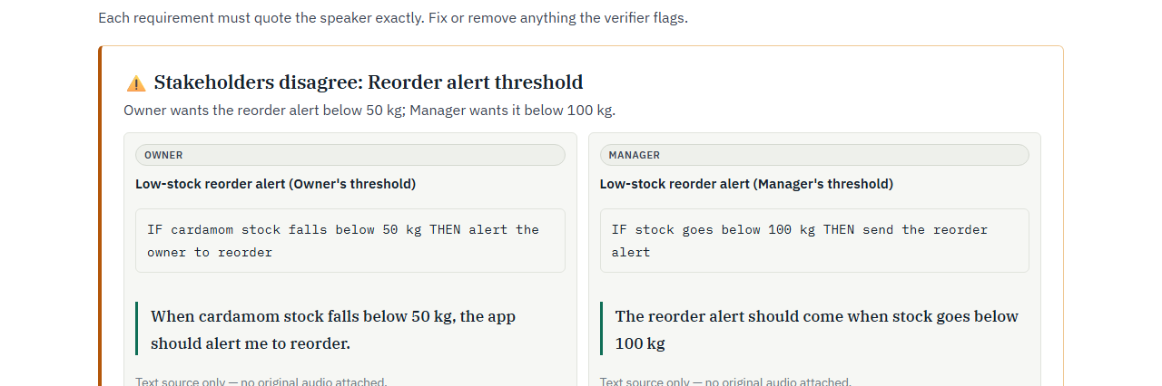
Product demo
Live screen: owner and manager disagree, VAANI shows both
Real screenshot from the running product: 2-speaker meeting demo, review step.
Notes:
This is a real screenshot of the running product (review step of the two-speaker meeting demo). The example includes voice input, an extracted rule with the confirmed-order exception, a stock dashboard with a 72-hour purchase pause and a Dhandha Twin replay. The 2% USD/INR threshold is a supplied demo assumption that requires owner confirmation, not a value reliably inferred from the short displayed transcript. ₹4.2 lakh is an illustrative potential-impact figure copied from the supplied outline. No measured savings or validated market dataset were supplied. A real replay must disclose data, baseline, transaction costs and assumptions. Screenshot captured by the Playwright suite.
Sources: User-supplied seven-slide VAANI outline (Pasted text.txt). Visual reference: https://notebook.google.com/notebook/032263ef-21e1-4d8b-8fb0-787156850e2c/artifact/38578414-83aa-4f77-8d5d-9e8abc2d5def
The project brief, technical build and execution plan named in the outline were not supplied separately. Every capability on this slide is implemented in the repository and covered by 58 backend tests and 11 browser flows (verified 17 Oct 2026).

Slide 7
Others
Why VAANI is different
Vernacular first
Usable outputs
Spoken-number verifier
Business owners describe rules in their own language.
A 12-section BRD, Jira CSV and a working first app.
A number nobody said is blocked, in Python and in the browser.
Accessible by design
Traceable decisions
Stakeholder conflicts
Standard, Low Vision and Deaf modes.
Awaaz Proof connects outputs to the owner’s voice.
Owner vs manager disagreements, shown with both voices.
“The person who knows the business
is the person who approves the software.”
AIForge × VAANI
Speak it. Verify it. Build it.
Notes:
Differentiation is grounded in the proposed design: vernacular business logic, a working prototype plus BRD, deterministic replay, three accessibility modes, source-linked traceability and confirmation before collecting payment. The replay is a scenario analysis, not a prediction or guarantee of savings. Closing statement adapted from the user-supplied quote by removing the unsupported first-ever claim.
Sources: User-supplied seven-slide VAANI outline (Pasted text.txt). Visual reference: https://notebook.google.com/notebook/032263ef-21e1-4d8b-8fb0-787156850e2c/artifact/38578414-83aa-4f77-8d5d-9e8abc2d5def
The project brief, technical build and execution plan named in the outline were not supplied separately. Every capability on this slide is implemented in the repository and covered by 58 backend tests and 11 browser flows (verified 17 Oct 2026).

